Slide 1
Blended Learning as a Strategy for Enhancing the Communicative Competence of Nigerian University Students
Kehinde A. Ayoola
Obafemi Awolowo University, Ile-Ife

Slide 2
ABSTRACT
This paper investigates the impact of a blended learning on first year students’ communicative competence and academic performance in GST 111 – Communication in English course at a Nigerian science and technology university. The learning-centred approach integrates a multimedia instructional package and WhatsApp-based content delivery with traditional face-to-face classroom teaching. Grounded in the Community of Inquiry (CoI) framework, the study evaluates how social, cognitive, and teaching presence contribute to meaningful language learning.

Slide 3
INTRODUCTION
The integration of digital technologies into educational practices has become a defining feature of 21st-century pedagogy, fundamentally reshaping teaching and learning processes across various academic disciplines.
Blended learning, which combines traditional face-to-face instruction with online educational experiences, has emerged as a promising approach for enhancing learning outcomes.
By offering students flexible access to learning materials and fostering collaboration beyond the physical classroom, blended learning leverages technological advancements to promote deeper engagement and improved understanding.

Slide 4
Despite its growing global popularity, the adoption of blended learning for English language acquisition is not as popular as expected in Nigerian tertiary institutions, especially in science and technology-based universities (Olugbade, 2023). Traditional face-to-face teaching methods continue to dominate instructional practices, often limiting opportunities for technology-enhanced learning. Addressing this gap, the present study introduces a blended learning approach that integrates an instructional package which was developed using Microsoft PowerPoint and enhanced with graphics, simulations, images, text, and voiceover features, delivered to students via smartboards, WhatsApp platforms, alongside conventional classroom instruction.

Slide 5
GST 111 – Communication in English falls within the ambit of English for Academic Purposes (EAP) in view of the design of the course to meet the specific needs of a homogenous group of learners in an academic setting. According to Shing and Sim (2011), the growth of EAP is derived from the awareness that university students possess different learning needs that cannot be fulfilled by teaching the same type of English to all categories of students. Indeed, EAP, according to Hutchinson and Waters (1987) gives a high priority to the language forms students would meet in their studies and a low priority to forms they would not meet.

Slide 6
In view of the function of English as Nigeria’s official language and language of education, in addition to addressing relevant EAP skills and sub-skills, the course curriculum must of necessity accommodate pedagogical styles that enhance the acquisition of English by learners in a non-native context. Specifically, the course should focus on the receptive skills of listening and reading and the productive skills of speaking and writing.

Slide 7
Orr (2001) observes that the content of EAP is not fixed, but it is enriched according to the requirements of the learning context. Aside from addressing the linguistic needs of specific disciplines, Teoh (1995) suggests that a well-designed EAP course should be able to enhance students’ ability to work on their own. In this way, students will become better and more independent learners; hence they will be equipped to take greater responsibility for their own learning. Underlying the communication in English curriculum for Nigerian universities are EAP perspectives on linguistic and communicative competence, and issues relating to the basic language skills viz.: listening, speaking, reading and writing.

Slide 8
Statement of the Problem
Previous studies emphasize the importance of student characteristics, instructional design, and technology-mediated engagement in determining learning outcomes (Kintu, Zhu, & Kagambe, 2017). Furthermore, studies within the Nigerian context affirm the transformative potential of mobile technologies and digital tools in shaping academic engagement and entrepreneurial development among tertiary institution students (Ojo, Olugbade, & Abioye, 2023). However, there has not been sufficient research on the use of the blended learning approach and the evaluation of its impact on the communicative competence and academic performance of Nigerian science and technology university students.

Slide 9
Aim and Objectives
This paper, therefore, evaluates the impact of blended learning intervention on first year students’ communicative competence and academic performance in the GST 111 – Communication in English course at a Nigerian science and technology university.
The specific objectives of the study are to evaluate the impact of blended learning on students’ communication in English skills, and examine students’ attitudes and motivation towards the use of blended learning approaches for English language learning by Nigerian university students.

Slide 10
The Use of Technology for Learning in Higher Education
The advent of multimedia has made it appropriate and indeed mandatory for Nigerian universities and colleges to revise their approach to the teaching and learning of Communication in English, so that the course can be made more accessible to the new generation of learners, who have been aptly described by Raji-Oyelade (2014, p.15) as “netizens” or “digital citizens”. The foregoing raises a number of questions on the use of technology for the teaching and learning of Communication in English in Nigerian universities:

Slide 11
To what extent is blended learning incorporated into Communication in English curriculum?
How equipped are Communication in English instructors in the use of multimedia to supplement their teaching?
Are Nigerian university lecture rooms adequately equipped for the use of multimedia for teaching and learning Communication in English?
Do Nigerian first year students possess smartphones, computers and the requisite data for effective use of Google classroom, Microsoft Team WhatsApp platform and more that are often required for blended learning?

Slide 12
Blended learning has gained prominence as an instructional model that combines the strengths of both face-to-face and online learning, offering flexibility, increased engagement, and improved academic outcomes. Research has shown that students in blended learning environments often outperform those in traditional learning settings due to enhanced access to content, increased opportunities for interaction, and greater learner autonomy (Owston, York, & Murtha, 2013; Vallée et al., 2020). Hrastinski (2019) emphasizes that blended learning promotes active and collaborative learning through both synchronous and asynchronous modalities, enabling students to participate more meaningfully in the learning process.

Slide 13
the ongoing shift towards digital pedagogy has prompted some institutions to experiment with blended models, especially in the light of post-COVID 19 pandemic educational reform. In science and technology universities, where applied learning and industry relevance are crucial, blended learning presents a valuable opportunity to bridge theoretical knowledge with digital competence (Olugbade, 2023). Instructional packages incorporate multimedia elements such as simulations, graphics, and narration to enhance comprehension and retention. When thoughtfully designed, such packages foster cognitive engagement and self-paced learning. The use of mobile technologies such as WhatsApp further complements these tools by offering instant communication, real-time feedback, and flexible access to materials (So, 2016)

Slide 14
Theoretical Framework: Community of Inquiry (CoI)
Community of Inquiry (CoI) model (Garrison, Anderson, & Archer, 1999), identifies three essential elements for meaningful online learning: social presence, cognitive presence, and teaching presence:
Cognitive presence relates to critical thinking and knowledge construction. It encapsulates the extent to which communication is created, restricted or encouraged in a community of inquiry.
Social presence involves the ability of participants in a community of inquiry to project their full personality socially and emotionally using a particular medium of communication.
Teaching presence refers to professional input of a facilitator or teacher, the appropriate use of instructional design to guide the learning experience, testing and assessment, etc.

Slide 15
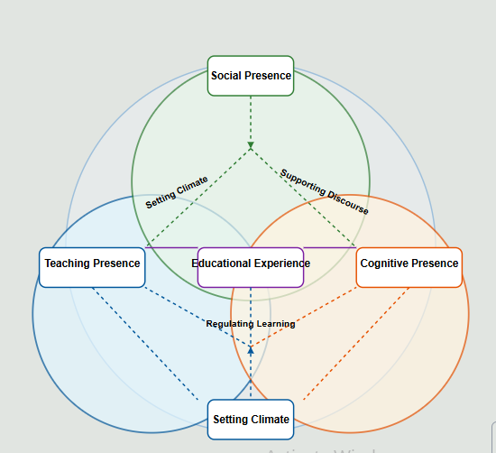
Community of Inquiry (CoI) Theoretical Framework

Slide 16
Using WhatsApp for Language Learning
WhatsApp, when used effectively, can support all three components. It enhances social presence through its collaborative tools, supports cognitive presence via multimedia content, and reinforces teaching presence through structured modules, feedback mechanisms, and synchronous interactions. By applying the CoI model, this paper discusses how these dimensions are supported in the context of GST 111, a foundational Communication in English course in Nigerian universities.

Slide 17
Methodology
The study employed a qualitative, quasi-experimental design to evaluate the impact of blended learning intervention on students’ communicative competence and academic performance. The intervention combined a multimedia instructional package and mobile instant messaging (WhatsApp) with traditional classroom teaching. The instructional package was designed using Microsoft PowerPoint and included audio narration, simulations, graphics, and contextual images. Course materials were distributed to students weekly via WhatsApp to encourage ongoing engagement and facilitate asynchronous learning.

Slide 18
Summary of Findings:
Online Links, Charts, Graphs & Videos
Teaching presence is achieved through the posting of online links, charts and graphs by the course instructors; cognitive presence is measured though the interactions between the participants comprising the tutors and the students; social presence is seen from the way the students post their responses and correct themselves freely with minimal inhibition.
The next slide contains online links supplied to enhance the students private study and understanding of the topics.

Slide 19
6 simple strategies to sharpen your study memory https://www.indiatoday.in/visualstories/education/6-simple-strategies-to-sharpen-your-memory-2-195221-17-12-2024
7 ways reading books can improve your English grammar and language skills https://timesofindia.indiatimes.com/education/web-stories/7-ways-reading-books-can-improve-your-english-grammar-and-language-skills/photostory/116443483.cms
8 memory-boosting Strategies for students in their 20s https://timesofindia.indiatimes.com/educatio/web-stories/8memory-boosting-strategies-for-students-in-their-20s/photostory/116155094.cms

Slide 20
Videos on Listening, Speaking, and Reading skills, with durations of not more than 10 to 15 minutes each, were posted on the class WhatsApp platform. The videos were produced by the university’s Language and General Studies Centre with the assistance of an authentic model voiceover. Aside from the advantage of exposing the students to Standard English pronunciation, the students could watch the videos individually, in pairs or in groups at their convenience. The tutors, who also doubled as researchers, were greatly encouraged by the feedback they got from the students.

Slide 21
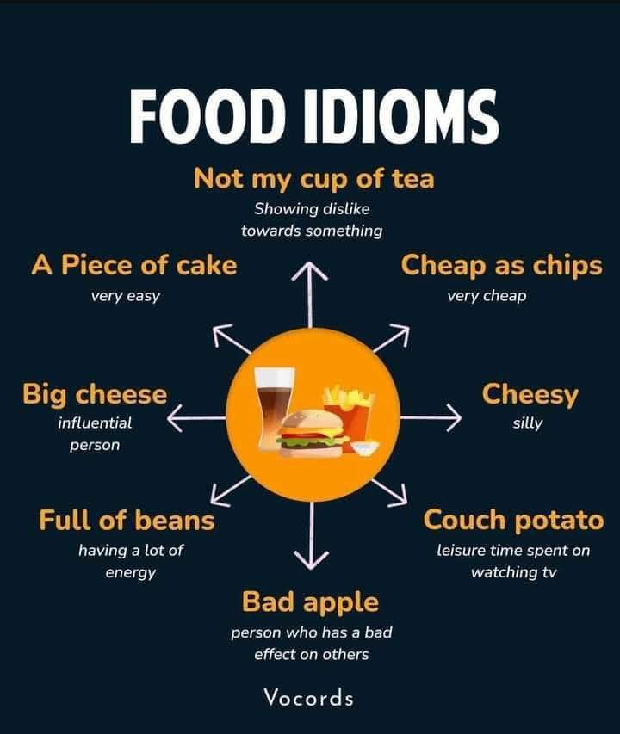
The Use of Multimodal Learning Aids

Slide 22
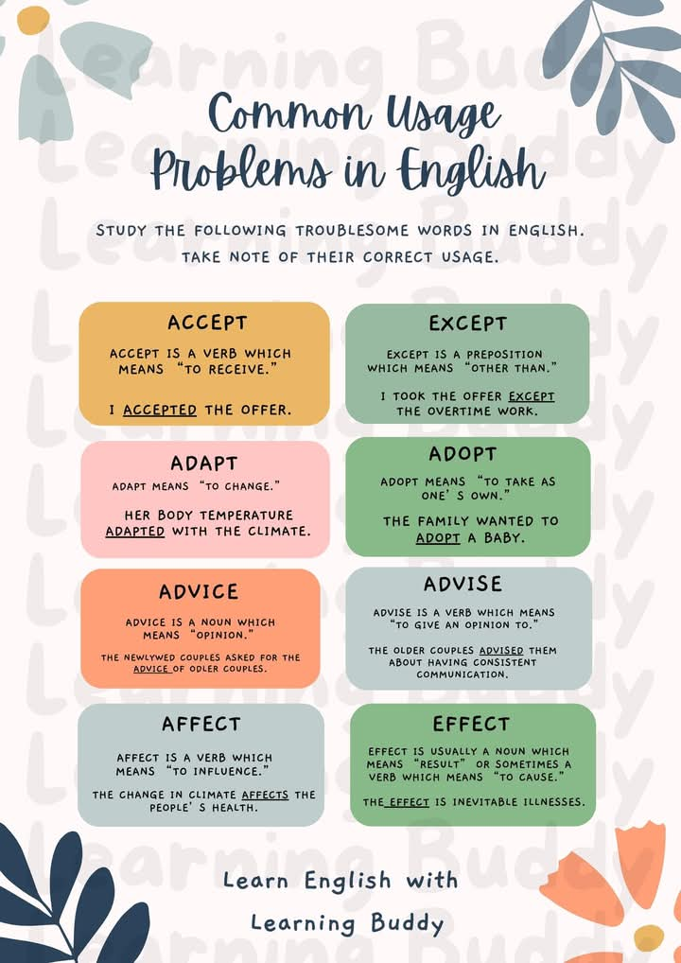
Frequently Confused lexical Items

Slide 23

Multimodal Illustration of Nouns and Verbs

Slide 24
The Advantage of Blended Learning Experience
The plates in the three previous slide above are picturesque or multimodal illustration of the systematic nature of language. Consequently, science and technology students can easily use the charts to make deductions and come to terms with systems guiding the formation of English words and the arbitrariness underlying the derivation of English idioms.
Online videos, charts and links are exciting self-learning multimodal tools that equip science and technology students for enhanced language learning. Not only does this strategy enhance greater teaching presence, but it also increases social presence on the part of the students and ultimately boosts their cognitive presence.

Slide 25
2. Online Question and Answer Sessions
The tutors found the GST 111 WhatsApp platform quite effective for teaching vocabulary development and grammar. Each student was asked to post three vocabulary items and use them in sentences.
The students were instructed not to repeat any vocabulary item that had been previously posted by other students.
The entire class served as umpires as anyone that broke the rules was called to order by their course mates.
More than 95% of the students responded to this exercise because they feared that their answers might be graded and used as part of their continuous asessment.

Slide 26
3. Online Essay Competition
An online essay competition was organised by the course tutors for submission on the WhatsApp platform. The contestants were required to write an essay titled “An Unnerving Experience”.
Students from each of the faculties on the course were asked to present contestants to represent them in the exercise. The rules guiding the essay writing were posted by the lead tutor and a specific date and time was set for simultaneous submission of the essays on the platform.
After submission, students were asked to select the best three essays through online voting.

Slide 27
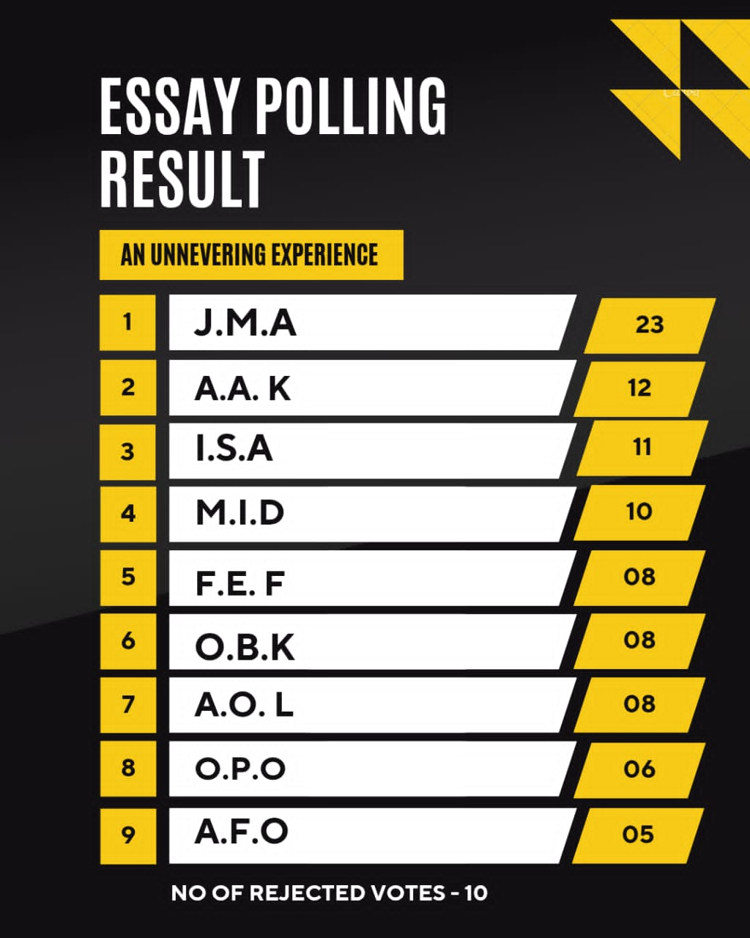
Summary of the Essay Competition Result

Slide 28
Uses and Abuses of AI by University Students
A careful look at the table shows that J.M.A. came first with A.A.K and I.S.A. coming far behind him in the second and third positions, respectively. Indeed, some of the essays were found to be flawless and completely devoid of grammatical errors expected of first year university undergraduates in the Nigerian second language context. Consider the extracts from J.M.A.’s “flawless” submission:

Slide 29
Extracts from an online essay submission
It was a humid summer night, and the air felt heavy and oppressive. … The streets were deserted, with flickering streetlights casting eerie shadows on the cracked pavement. … The buildings were old and lifeless, their windows like hollow eyes. A faint breeze stirred the leaves … Low murmurs, almost human but indistinct seemed to drift towards me. ,,, Suddenly, a shadow flitted across a nearby wall …
(Extract from J.M.A.’s online essay, bold highlights ours).

Slide 30
A cursory glance at the expressions in bold highlights point at advanced literary English in a native English context. The use of lexical items and collocations like ‘humid summer’, ‘air felt heavy and oppressive’, ‘flickering streetlights casting eerie shadows’ etc. roused the suspicion of the tutors that the piece was not original. After subjecting the submissions to “turnitin”, they arrived at the unanimous decision that six of the submissions were fully or partially artificial intelligence-generated. Consequently, all the entries were stepped down because they could not be relied upon as a true measure of the students’ performance. This singular “unnerving experience” raised serious doubts on the extent to which online submissions can be used for assessing students’ performance in essay writing.

Slide 31
Feedback from Student Participants
The students’ response to the questionnaire showed that they derived optimum benefits from the blended learning intervention. The fields covered by the questionnaire include skills acquisition and development, motivation for learning, ease of learning and positive attitude towards proficiency in the English language. Specifically, they observed that with blended learning, they were able to improve their English pronunciation, increase their vocabulary stock, enhance their listening, reading and writing skills and learn other skills that would boost their academic performance.

Slide 32
Conclusion
By leveraging online links, videos, charts and graphs on the class Whatsapp platform, science and technology students are better equipped to gain deeper understanding of language structures, vocabulary, grammar and usage, thus enhancing their communicative competence in the English language.

Slide 33
Thank you
for
Listening

